Slide 1
DSTL LAB (KCS 303) PROJECT BASED LEARNING

Slide 2
CRYPTOGRAPHY
SUBMITTED TO SUBMITTED BY
MISS JAYA SHARMA
MR. ROHIT VASHISHT AANYA GOEL(2100290110002)
ANUSHKA GUPTA(2100290110033)

Slide 3
CONTENTS
INTRODUCTION OF CRYPTOGRAPHY
USES IN DISCRETE MATHEMATICS
RSA ALGORITHM
STEPS OF RSA ALGORITHM

Slide 4
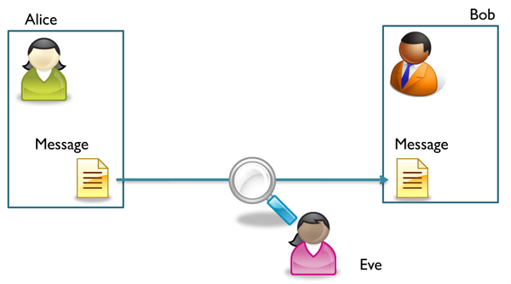
INTRODUCTION ABOUT CRYPTOGRAPHY
Cryptography is the study of techniques for secure transmission of information in the presence of adversaries.
Let’s take an example to understand it clearly.
How can Alice send secret messages to Bob
without Eve being able to read them?

Slide 5



PROCESS OF CRYPTOGRAPHY :
SENDER
RECIPIENT
ENCRYPTION
DECRYPTION
SECRET TEXT
CIPHER
SECRET TEXT
PUBLIC KEY
PRIVATE KEY

Slide 6
CRYPTOGRAPHY IN DISCRETE MATH..
The field of cryptography, which is the study of how to create security structures and passwords for computers and other electronic systems, is based entirely on discrete mathematics.
This is partly because computers send information in discrete — or separate and distinct — bits. Number theory, one important part of discrete math, allows cryptographers to create and break numerical passwords.
Because of the quantity of money and the amount of confidential information involved, cryptographers must first have a solid background in number theory to show they can provide secure passwords and encryption methods.

Slide 7
NUMBER THEORY IN CRYPTOGRAPHY
Applications of number theory allow the development of mathematical algorithms that can make information (data) unintelligible to everyone except for intended users. In addition, mathematical algorithms can provide real physical security to data—allowing only authorized users to delete or update data.

Slide 8
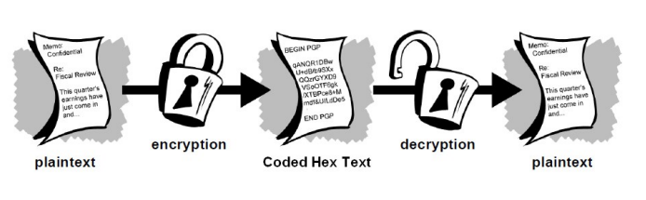
CRYPTOGRAPHY
A message is plaintext (sometimes called cleartext). The process of disguising a message in such a way as to hide its substance is encryption. An encrypted message is ciphertext. The process of turning ciphertext back into plaintext is decryption.
A cipher (or cypher) is an algorithm for performing encryption or decryption—a series of well-defined steps that can be followed as a procedure.

Slide 9

WHAT IS RSA ALGORITHM???

Slide 10
RSA ALGORITHM…
TO ENCRYPT AND DECRYPT THE STRING

Slide 11
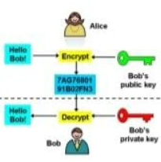
RSA OVERVIEW
SOLUTION FOR THE EXAMPLE ASKED IN STARTING USING RSA ALGORITHMS:
Bob has two keys: public and private.
Everyone knows bob’s public key, but only he knows his private
key.
Alice encrypts message using bob’s public key.
Bob decrypts message using private key.
Public key can encrypt, but not decrypt.
Therefore, no one can read message except Bob.

Slide 12
WHY WE USED RSA ALGORITHM??
The opposite key from the one used to encrypt a message is used to decrypt it. This attribute is one reason why RSA has become the most widely used asymmetric algorithm:
It provides a method to assure the confidentiality, integrity, authenticity, and non-repudiation of electronic communications and data storage.
2. The RSA encrypt key is encrypt the image, so that it convert into cipher text format and it will be store as a text file. The opposite method of encryption, the reverse process is compute by another one decryption key of RSA algorithm and it decrypts the image from the cipher text.

Slide 13
RSA HAS THREE STEPS :
CREATING KEYS
ENCRYPTING MESSAGES
DECRYPTING MESSAGES

Slide 14
STEP 1: CREATING KEYS
ø (n) = 1, i.e., >code>d is the multiplicative inverse of e in mod ø (n) Select two large prime numbers x and y.
Compute n = x * ywhere n is the modulus of private and the public key.
Calculate totient function, ø (n) = (x − 1)(y − 1).
Choose an integer e such that e is coprime to ø(n) and 1 < e < ø(n).e is the public key exponent used for encryption.
Now choose d, so that d · e mod

Slide 15
STEP 2: ENCRPTING KEYS
Messages are encrypted using the Public key generated and is known to all.
The public key is the function of both e and n i.e. {e,n}.
If M is the message(plain text), then ciphertext
C = M ^ n( mod n )

Slide 16
STEP 3 :DECRYPTING MESSAGES
The private key is the function of both d and n i.e. { d,n } .
If c is the encrypted cipher text, then the plain decrypted text M is
M = c ^d (mod n)

Slide 17

RSA ALGORITHM

